Slide 1

Stock Market Forecasting
a machine learning case study

Slide 2
Table of Contents
Business Background
Data Understanding and Exploration
Modeling and Evaluation
Deployment
Conclusion and Recomendation

Slide 3

Background
Data Scientist working at a brokerage firm.
As the data scientist of the firm, we are given a task to create a model to help stock market forecasting .

Slide 4

Business Objectives
The objective of this project is to help stock investors gain margin or high advantage in the stock market

Slide 5
Expected Output
The output of this project is a model prediction on the direction of the market stock trend to help analyst in stock market forecasting.

Slide 6
Project Limitation
With the limitation of time and data we will be focusing only on a certain number of stock exchange indexes

Slide 7
Analytic Approach
Machine Learning Technique
Supervised learning (clasification) to predict market direction
Perfomance Measures
Precision, Recall, F1, Accuracy

Slide 8
Data Collection
The dataset of stock exchange market is taken from Kaggle Stock Exchange Data by Mattiuzc
Data Shape
104,229 rows
9 columns

Slide 9
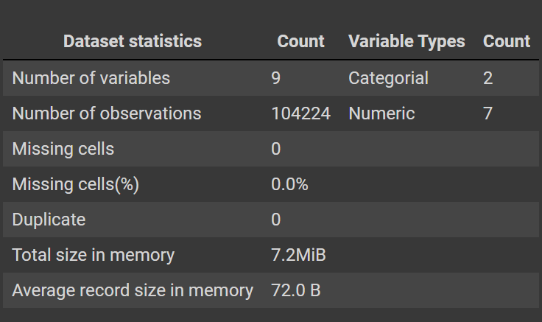
Data Description

Slide 10
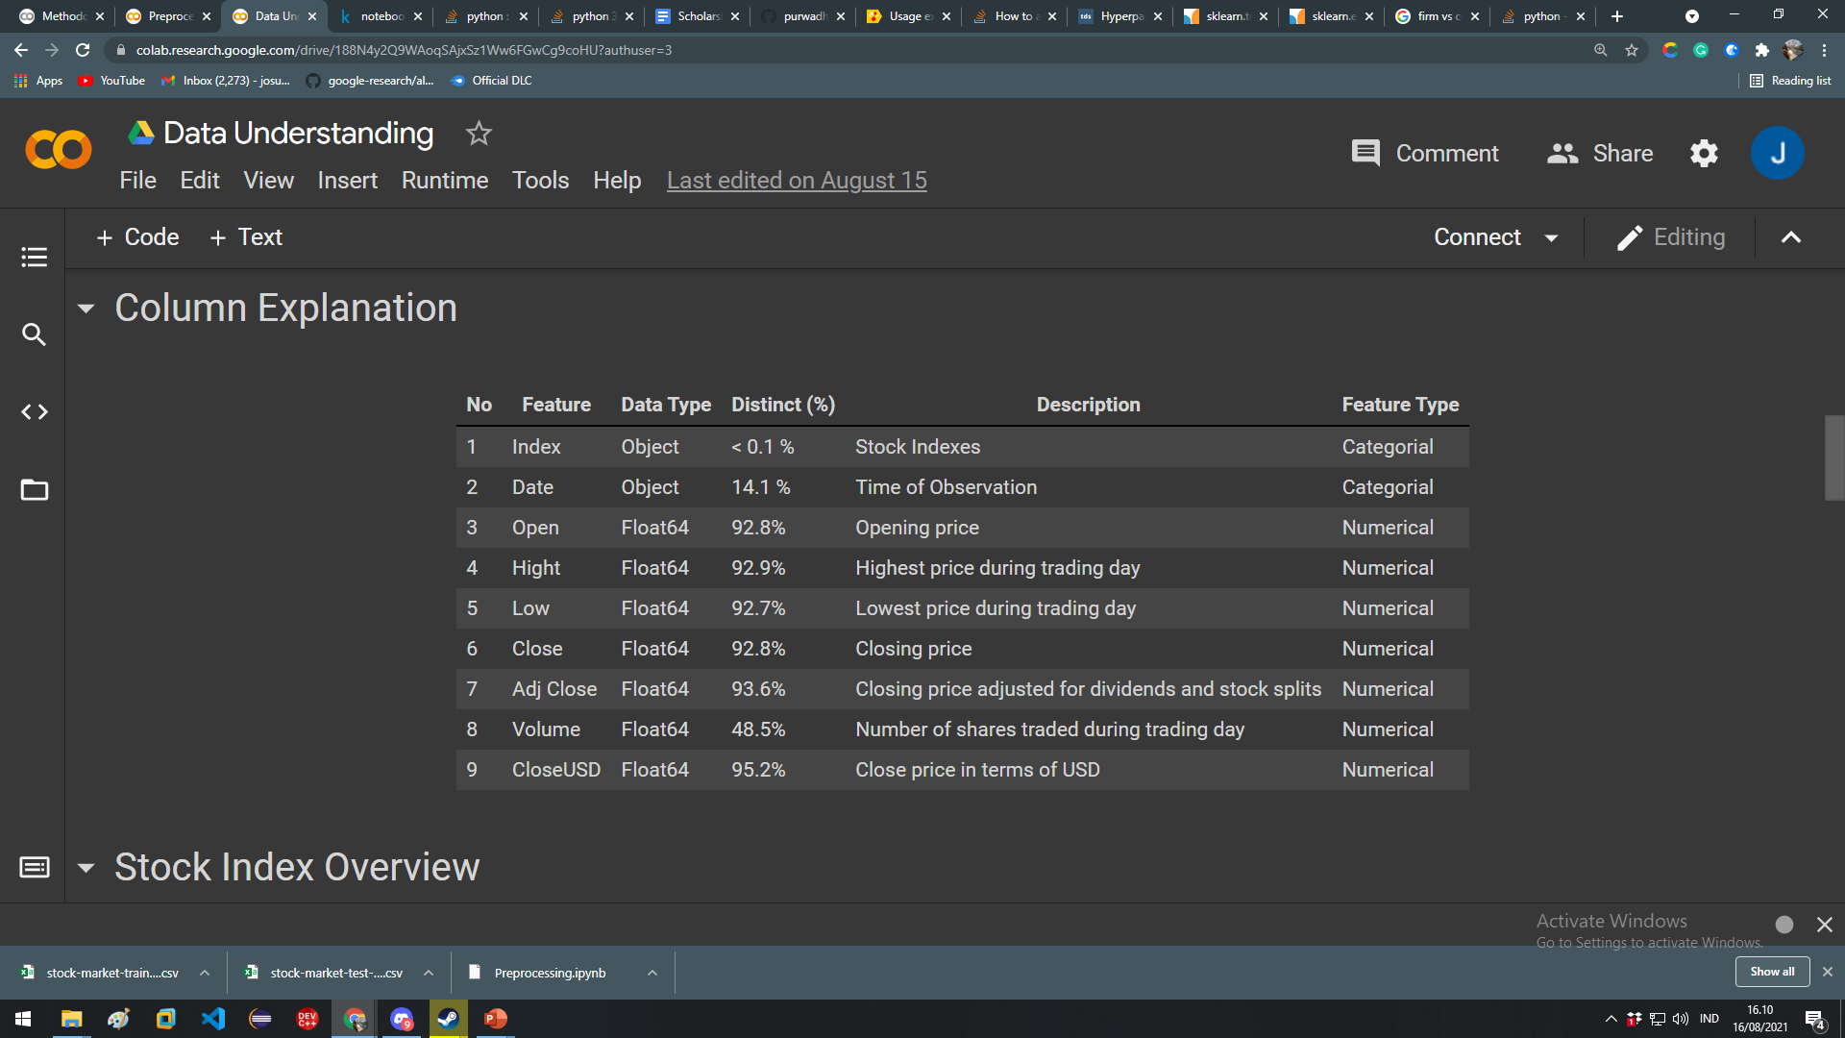
Column Explanation

Slide 11
Splitting Data set
Before preprocessing we will be splitting each indexes price history based on the date of the day. The split will be a 80 %, 20% split.

Slide 12
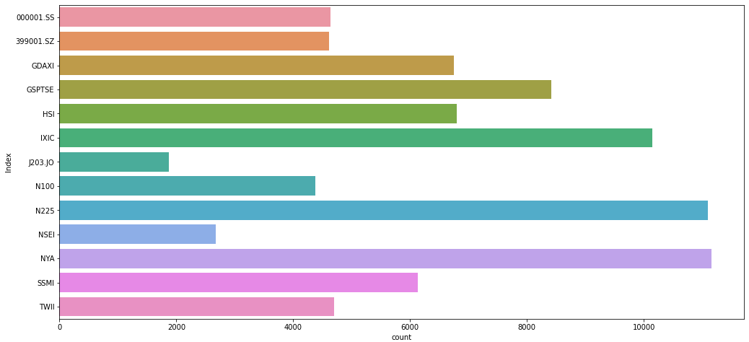
Index’s record distribution

Slide 13
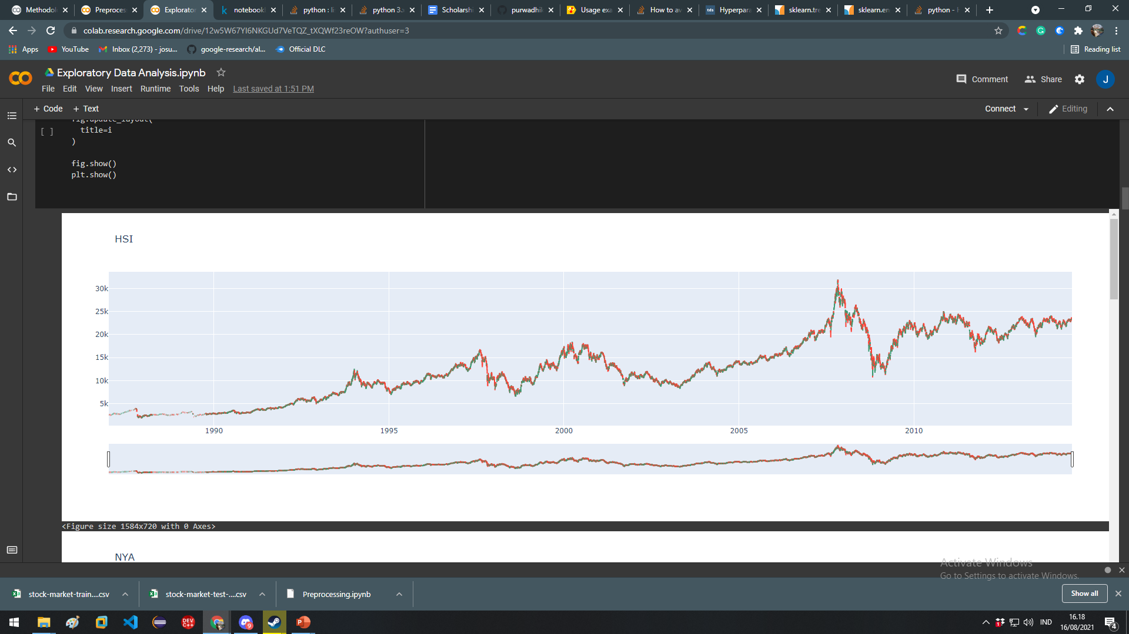
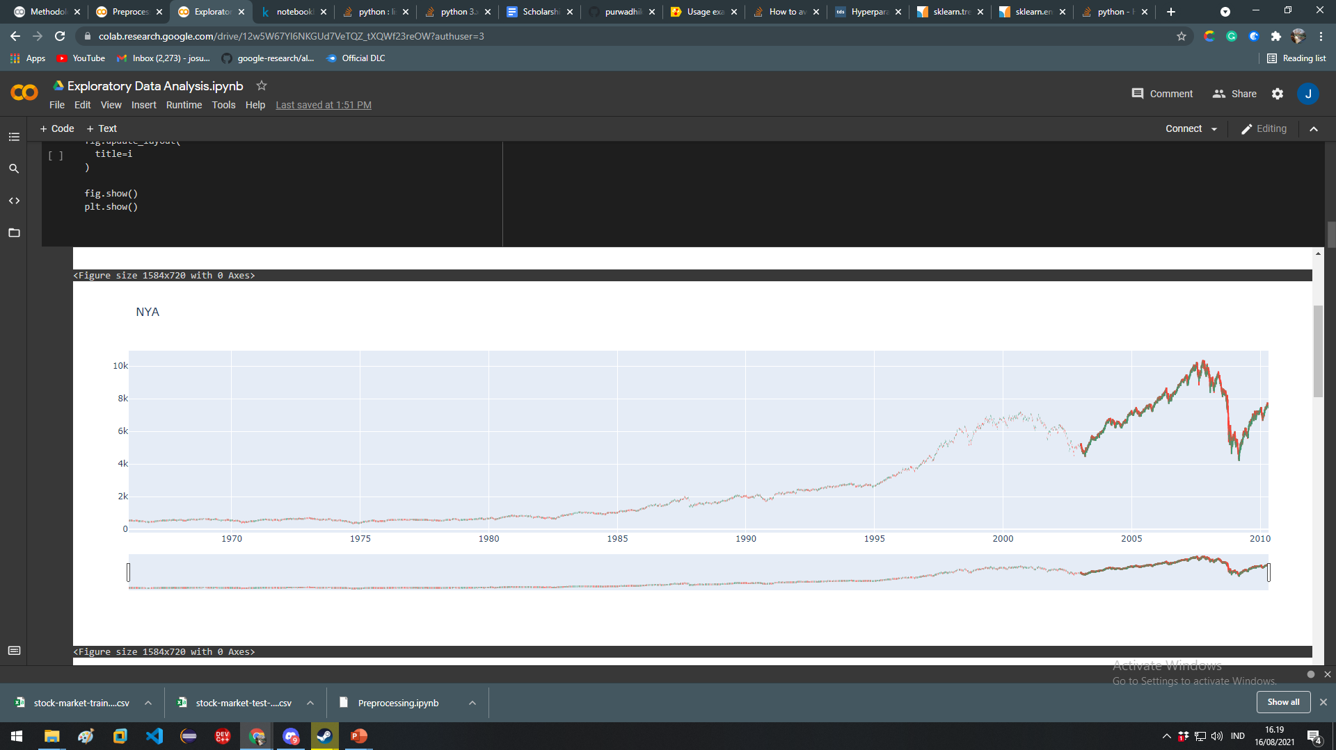
Opening and closing price based on their respective date

Slide 14
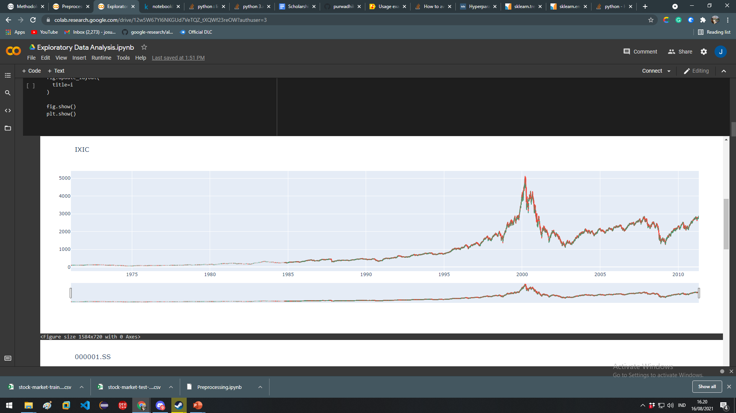
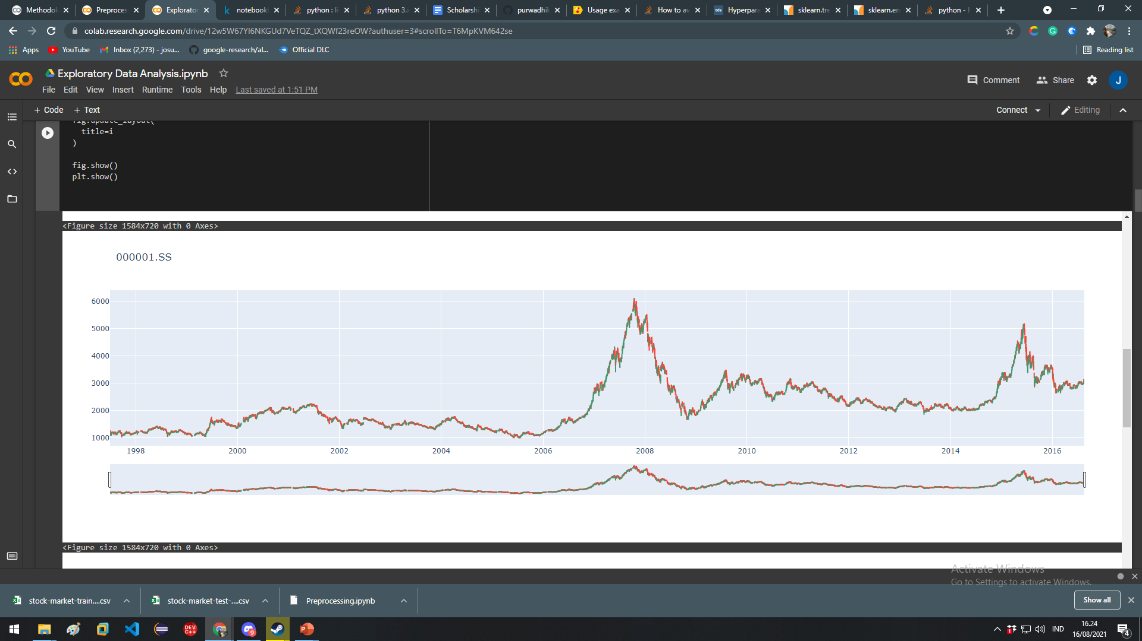

Slide 15
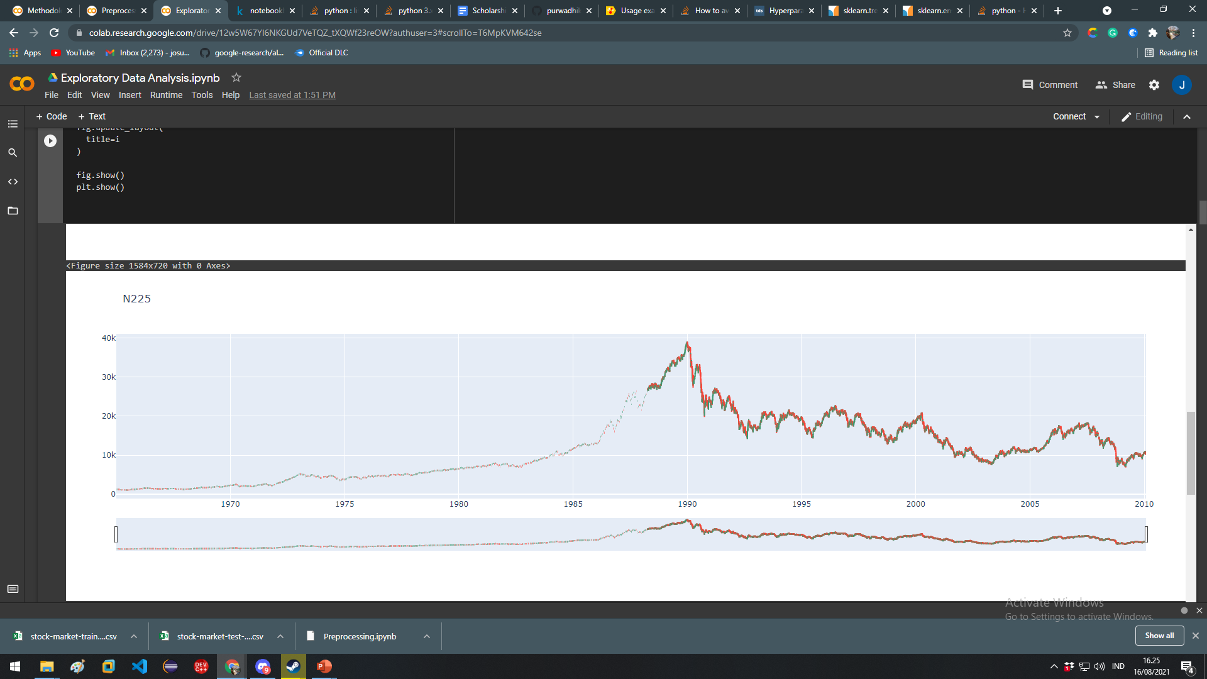
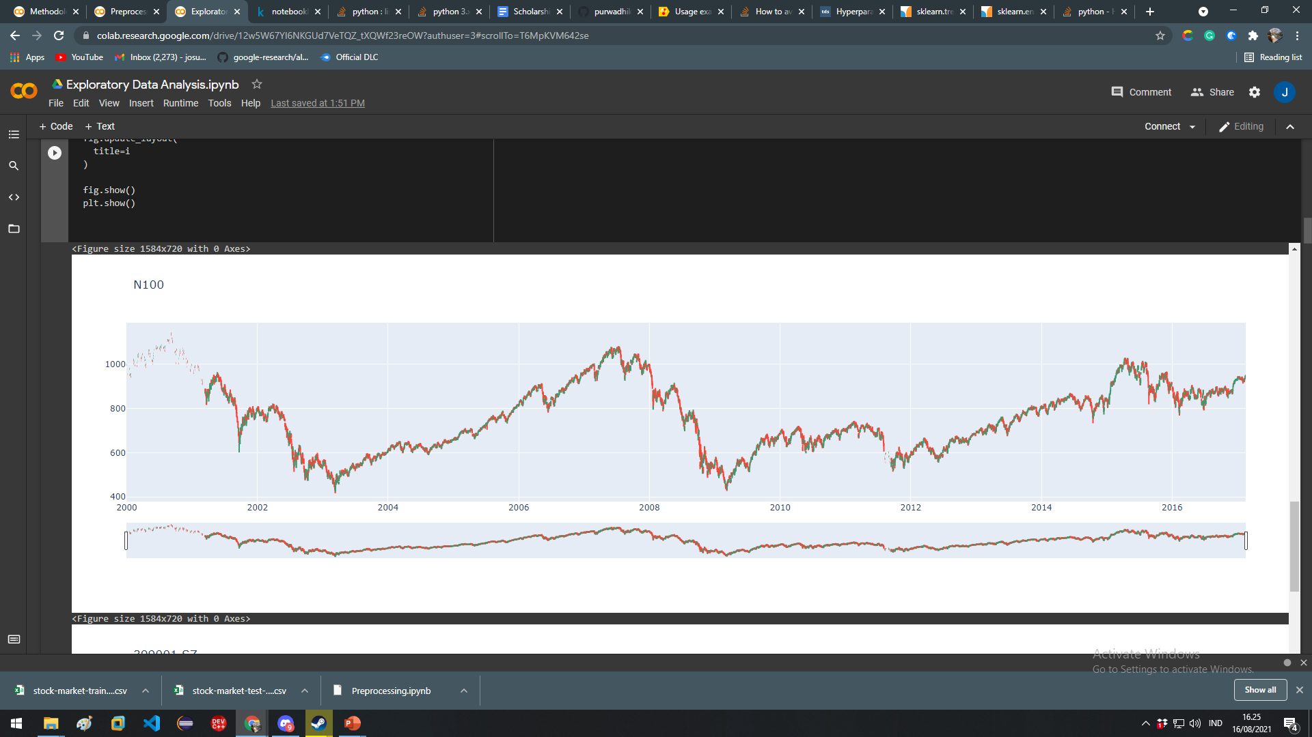

Slide 16
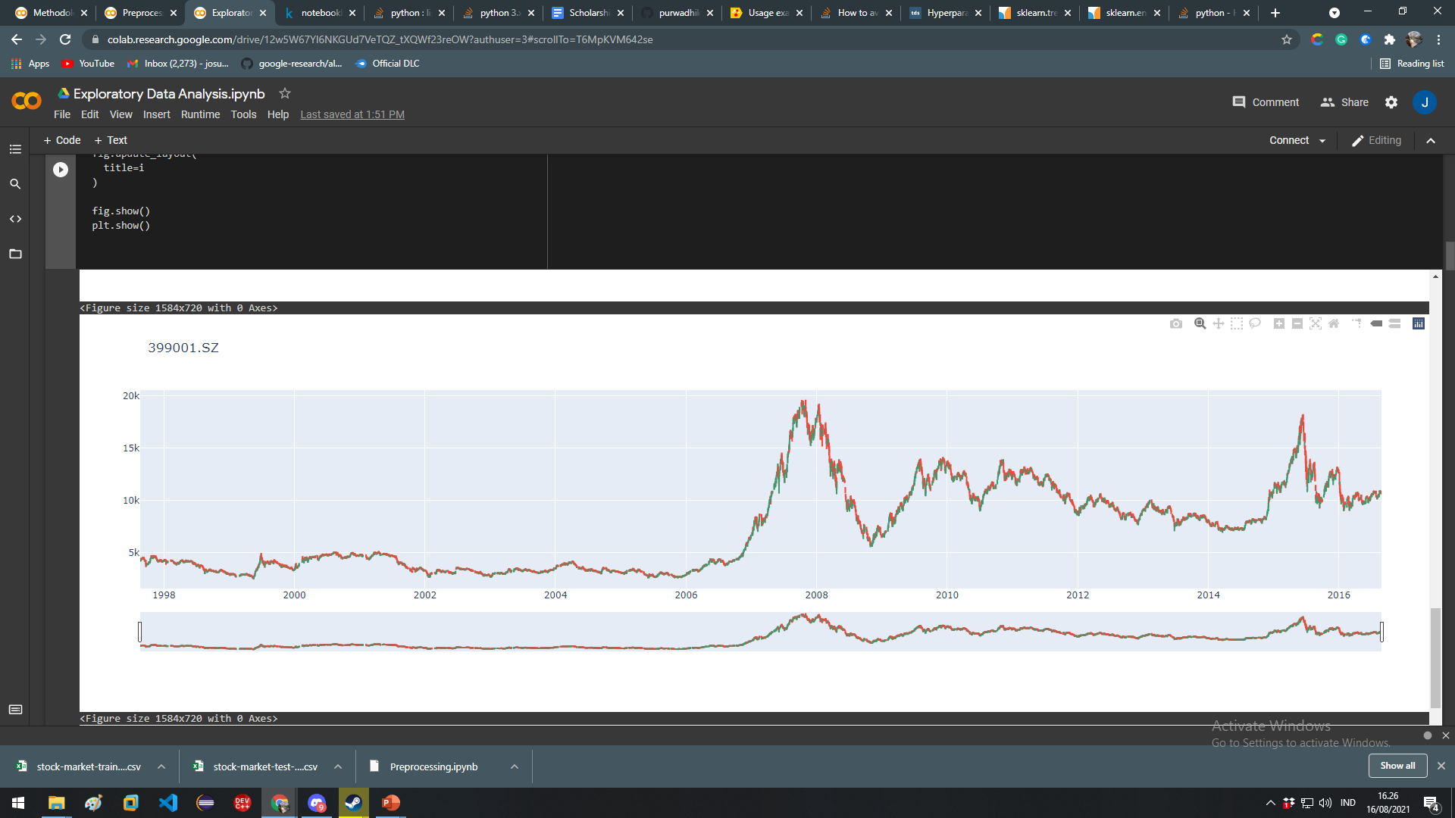
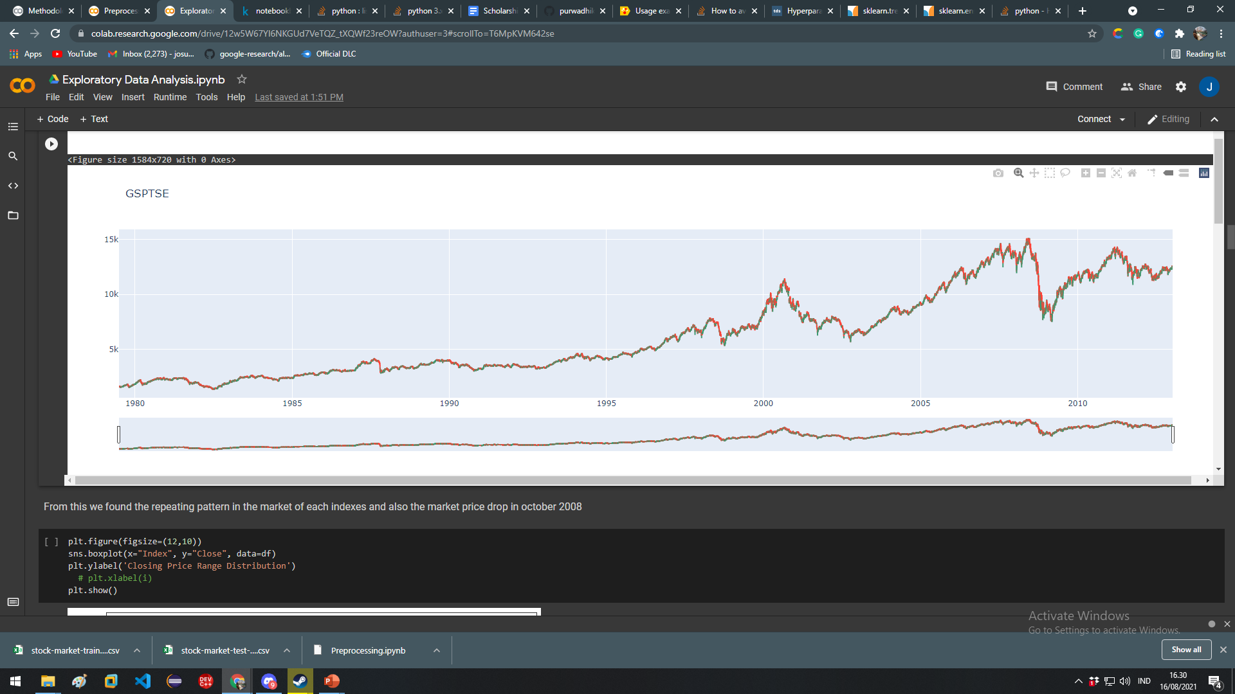

Slide 17
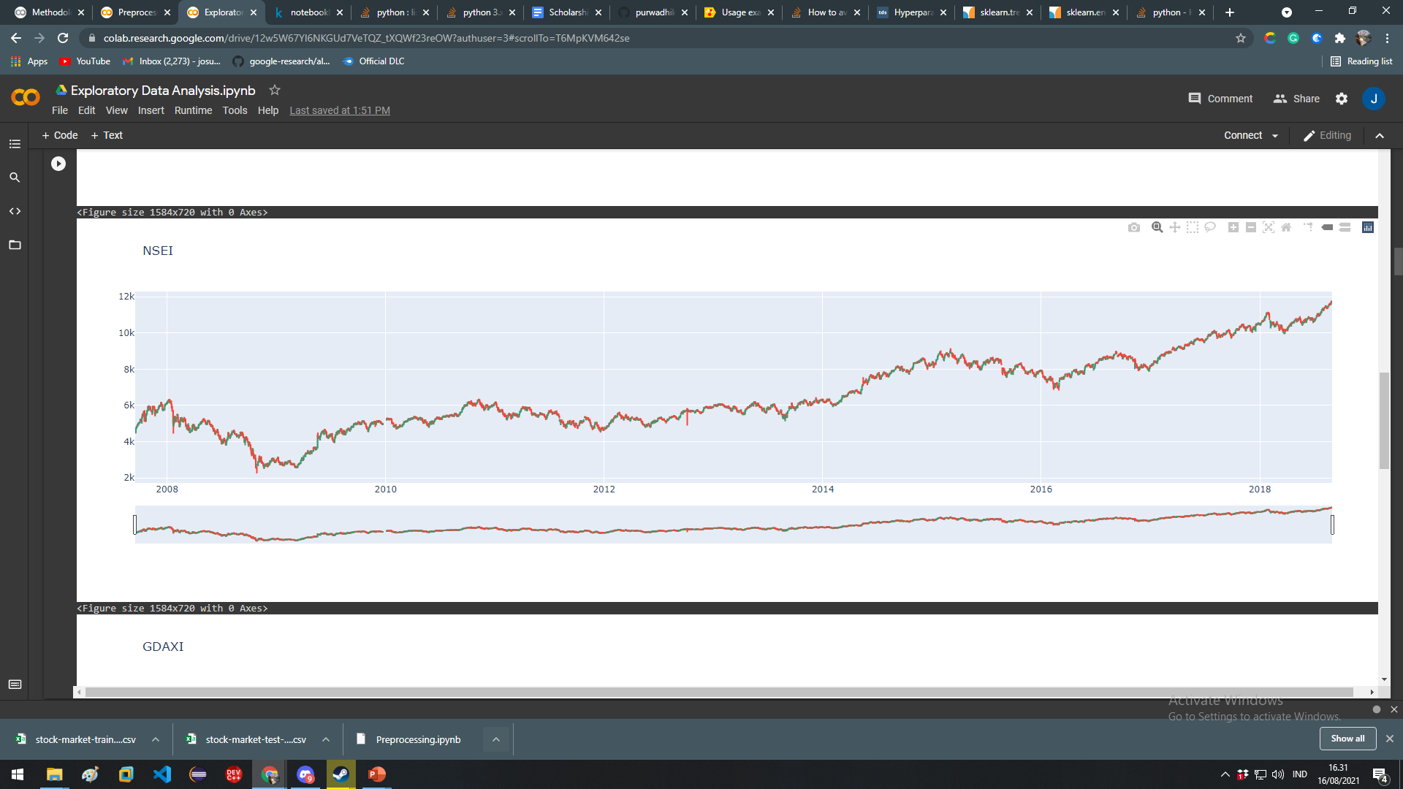
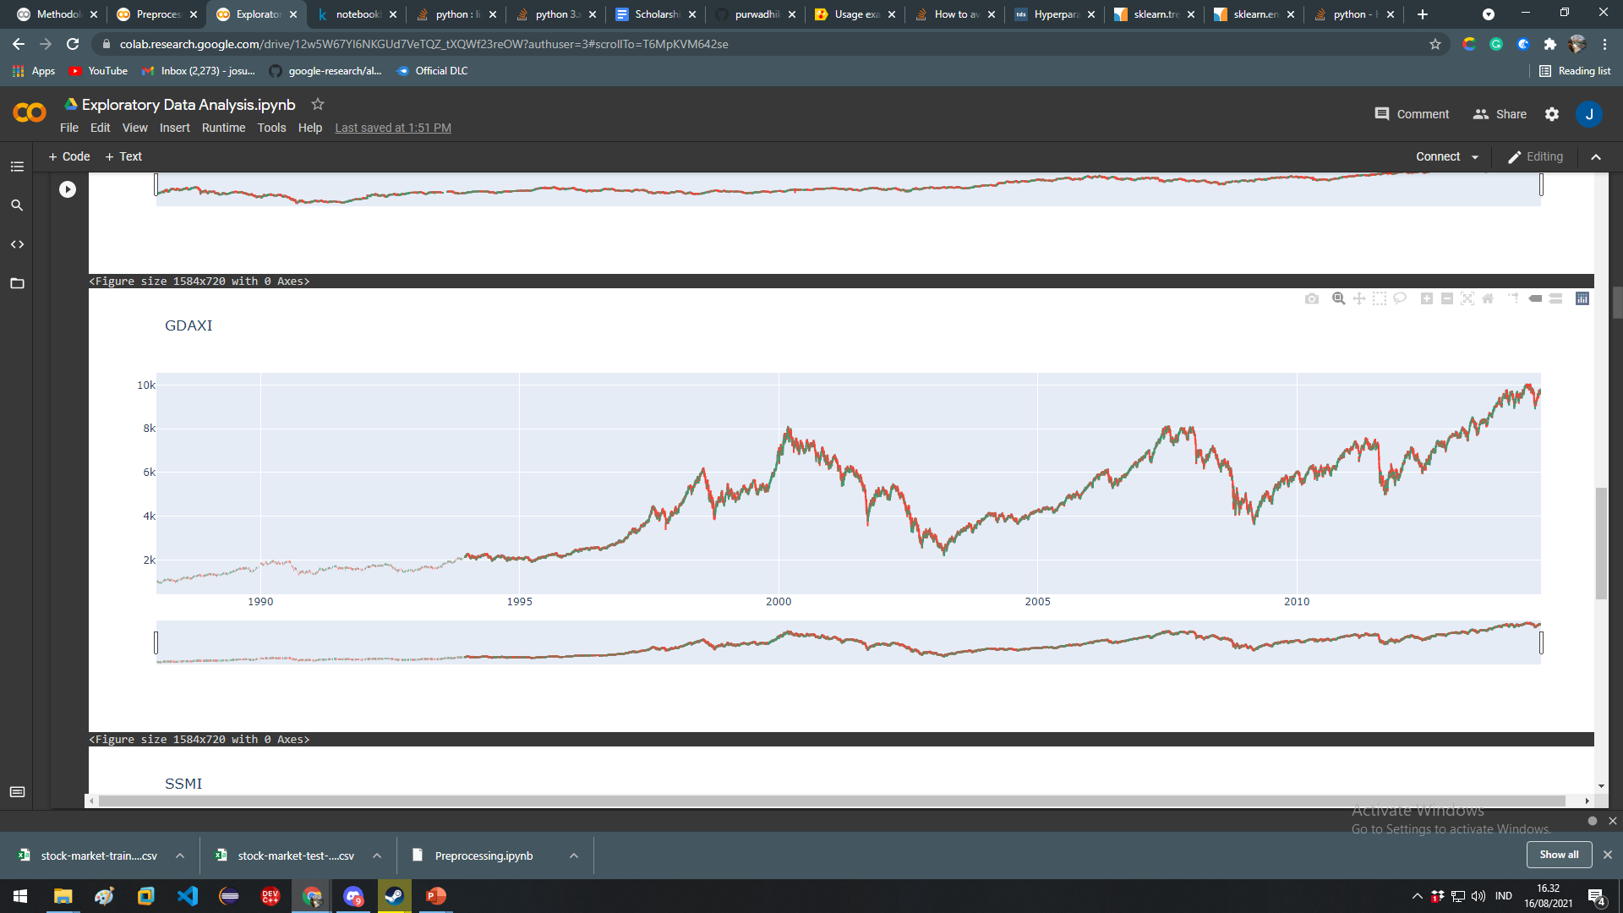

Slide 18
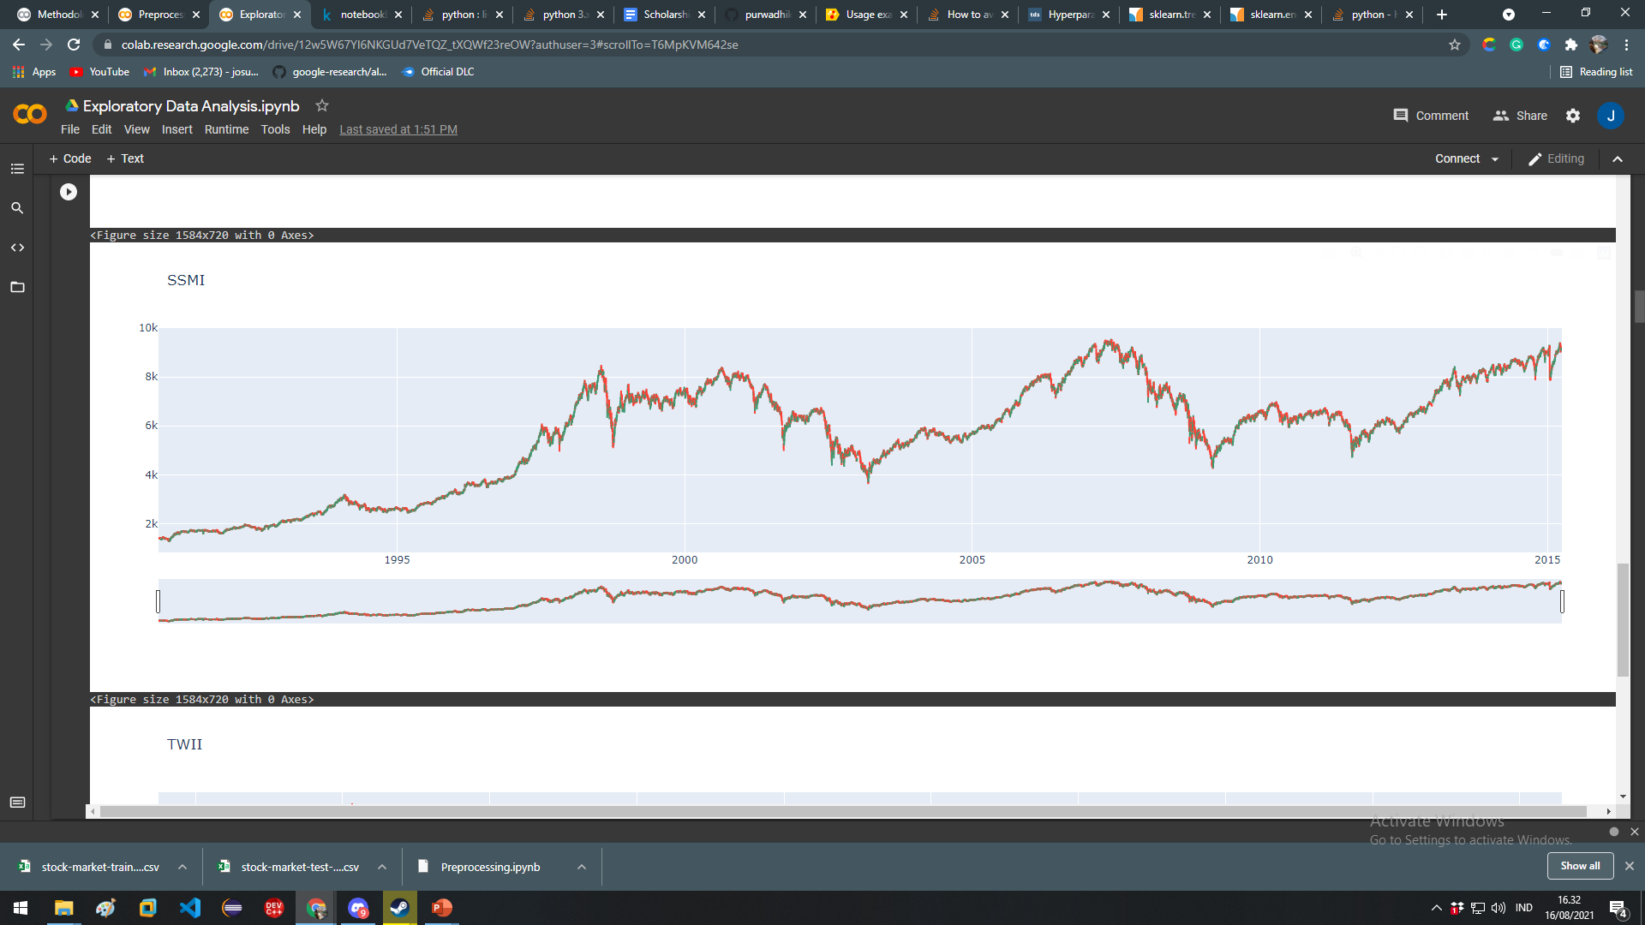
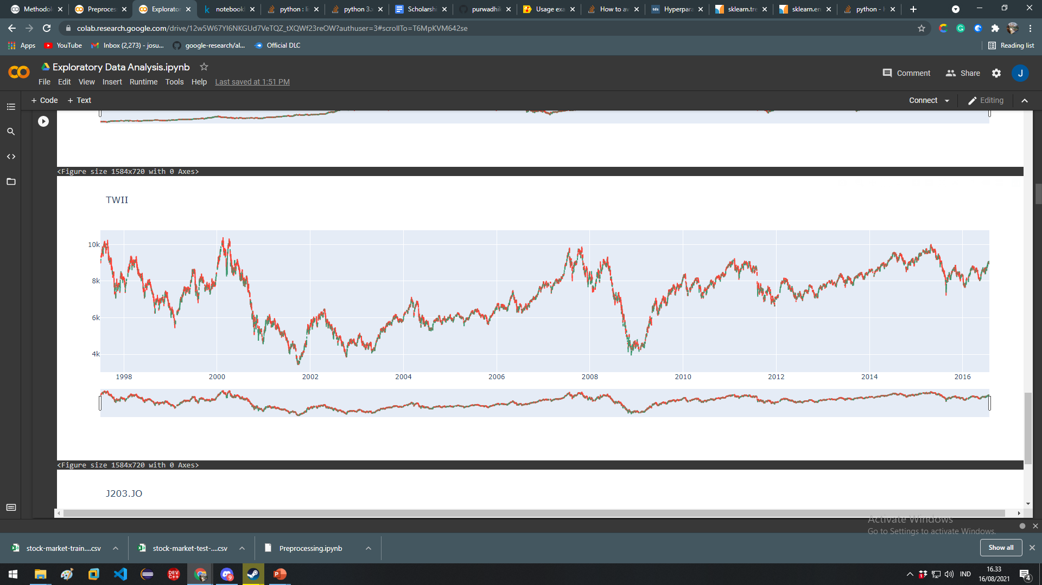

Slide 19
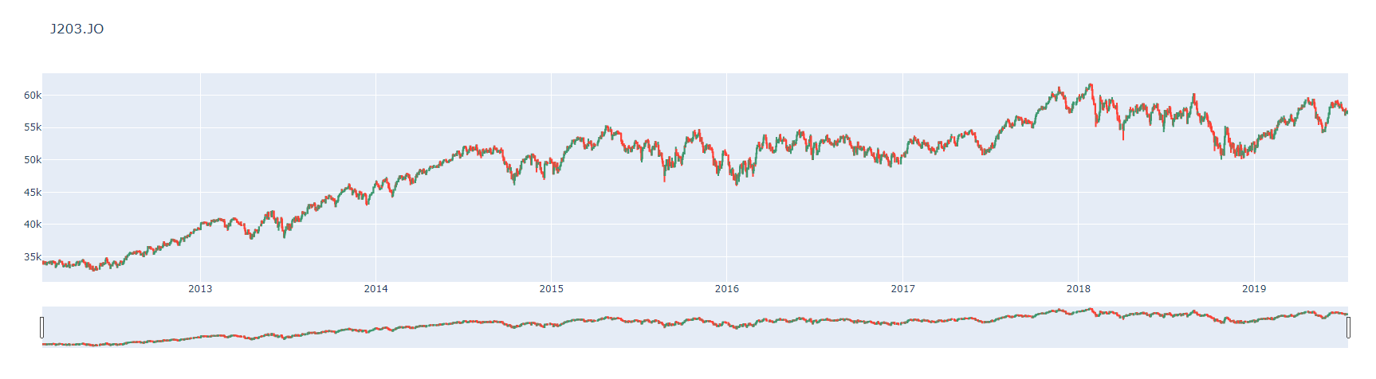
There are patterns occuring in the graph throught out the year we will try to generalize this pattern by smoothing the graph using moving averages.

Slide 20
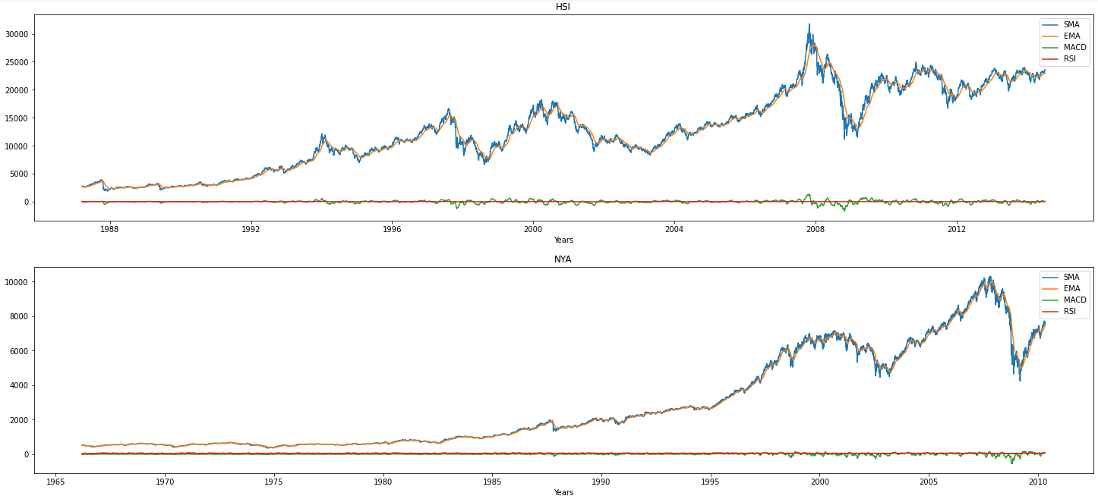

Slide 21
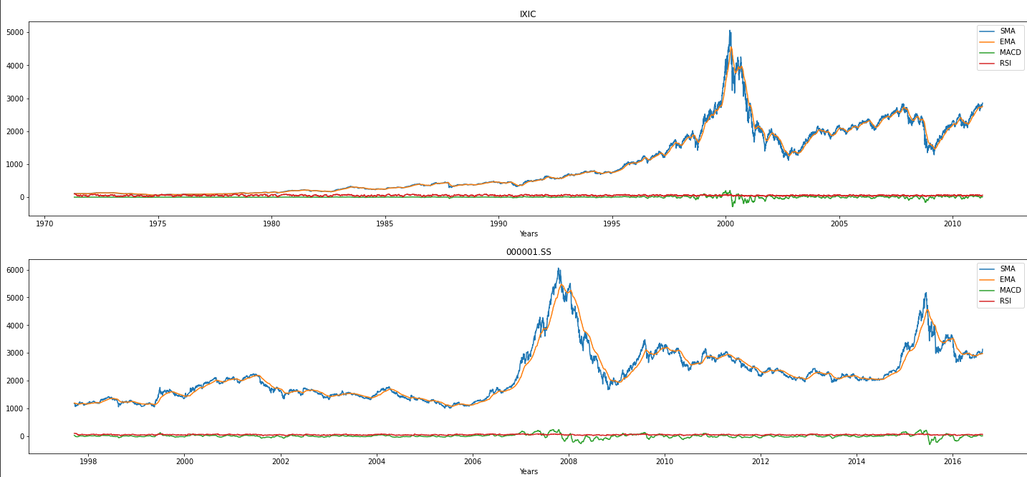

Slide 22
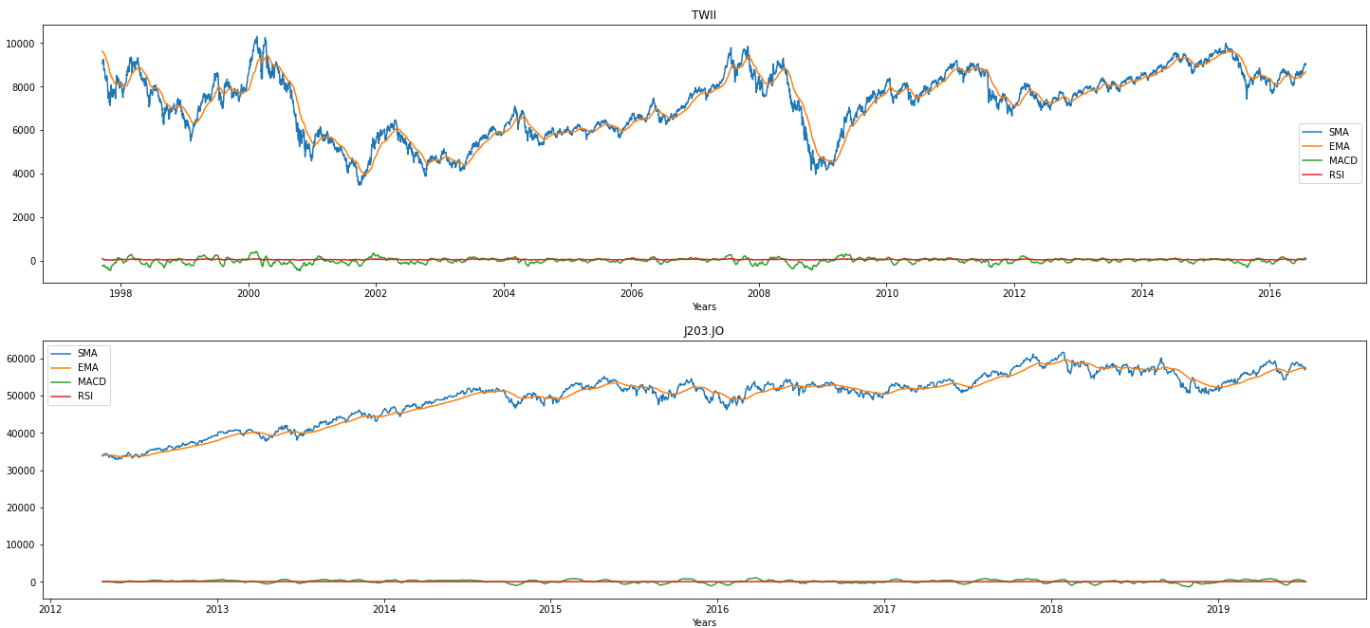

Slide 23
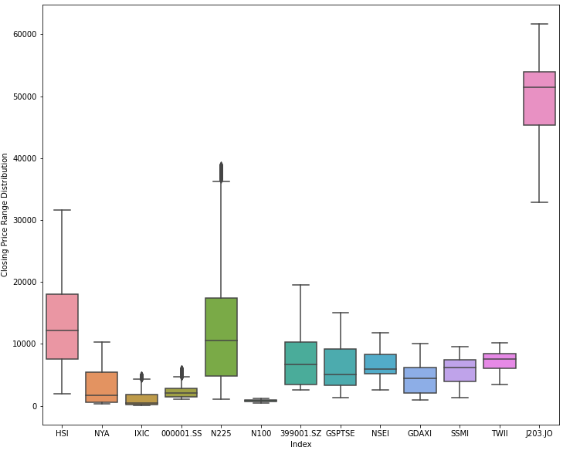
Closing price distribution
J203.JO shows a different price range than the other indexes

Slide 24
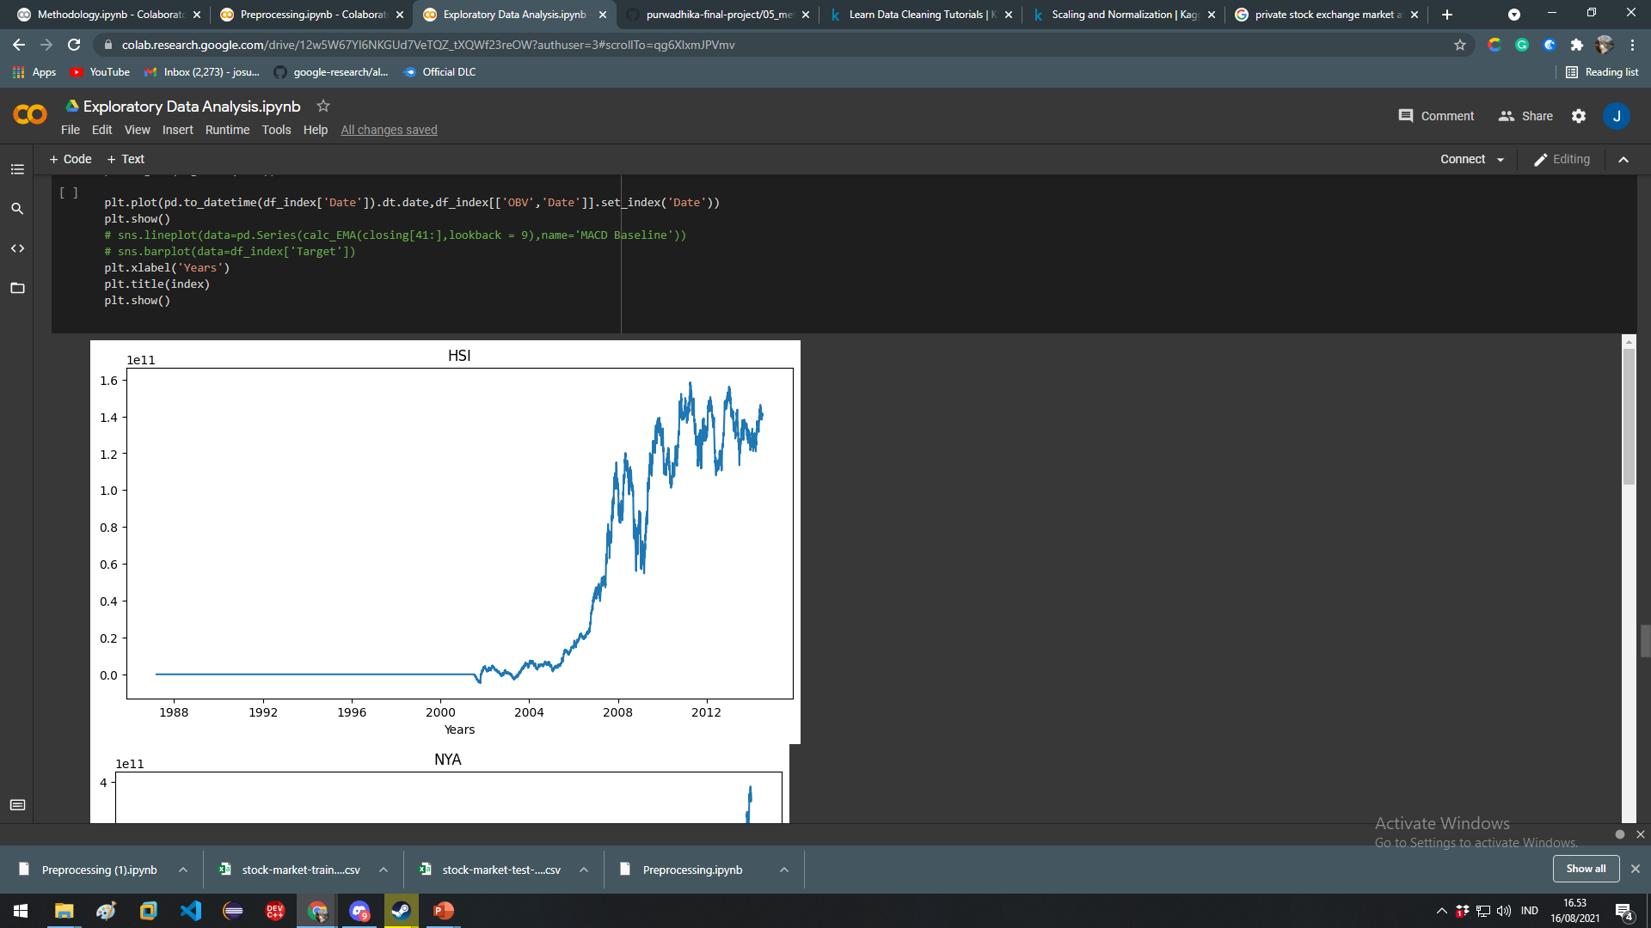
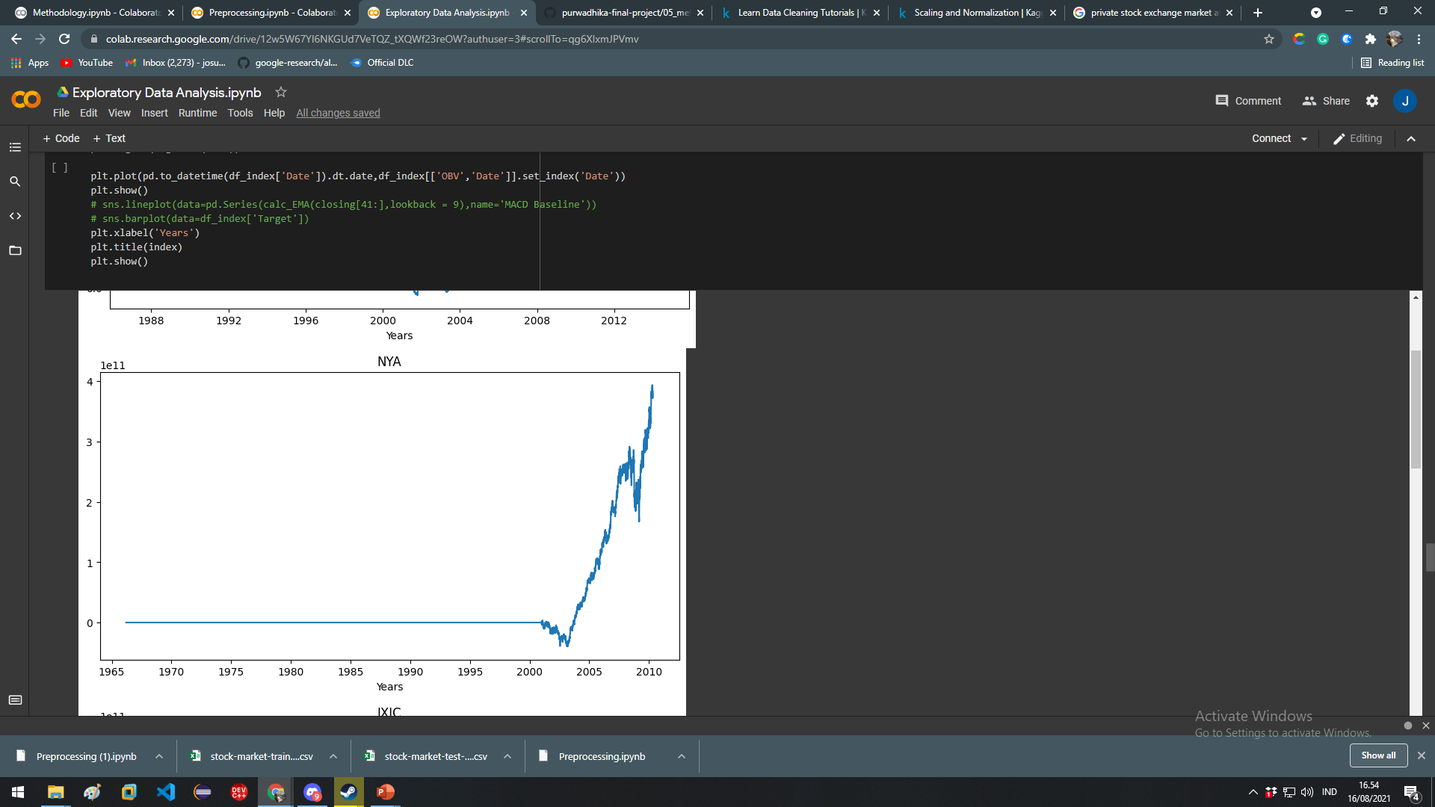
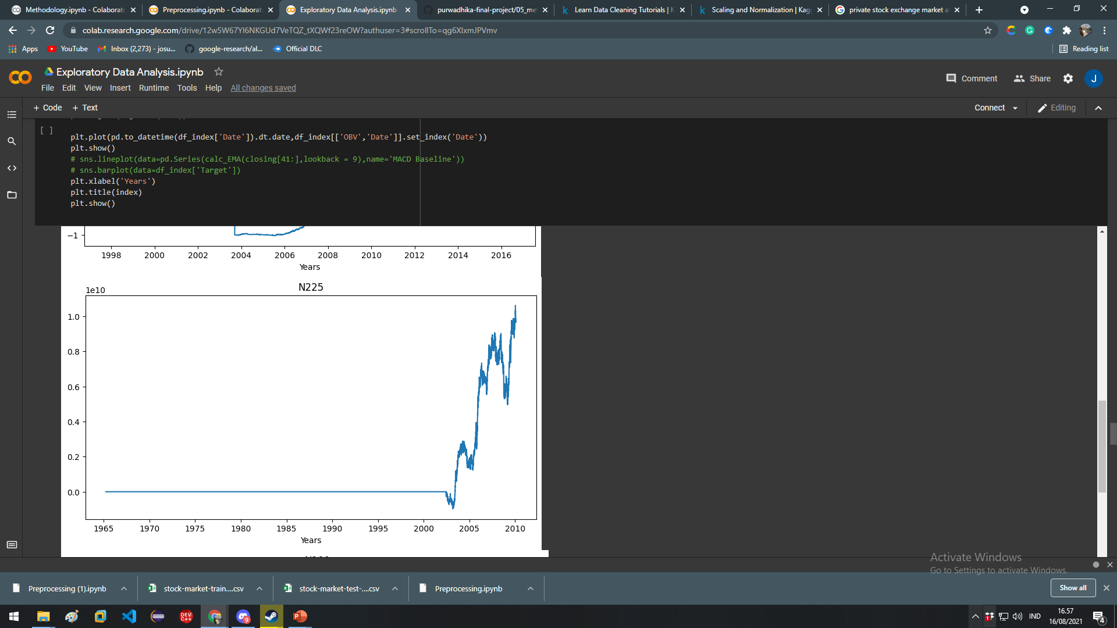

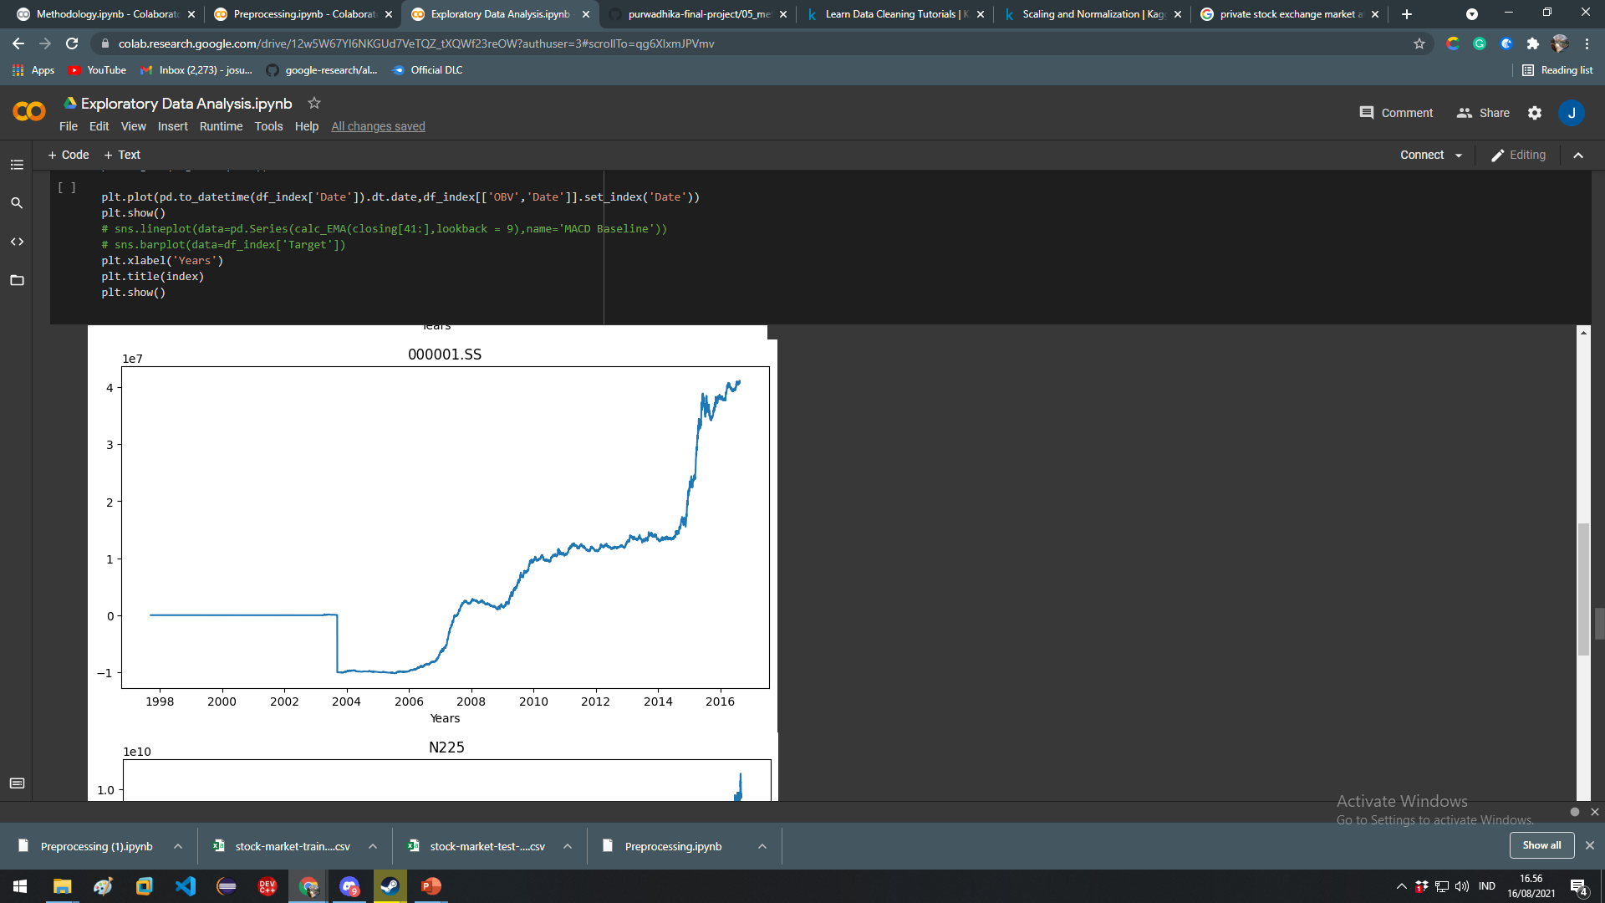
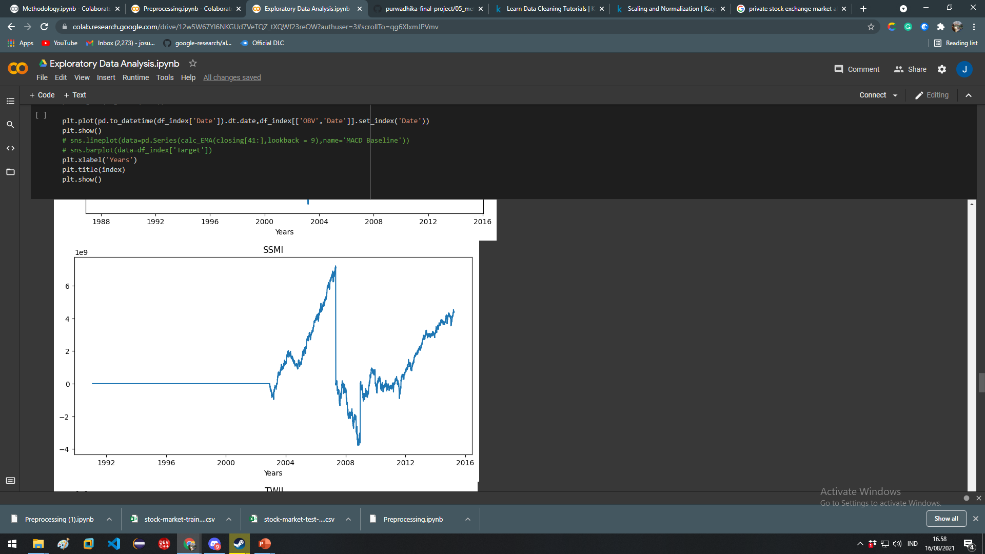
On Balance Volume of each indexes

Slide 25
Data Preprocessing
Feature engineering
Feature selection
Encoding

Slide 26
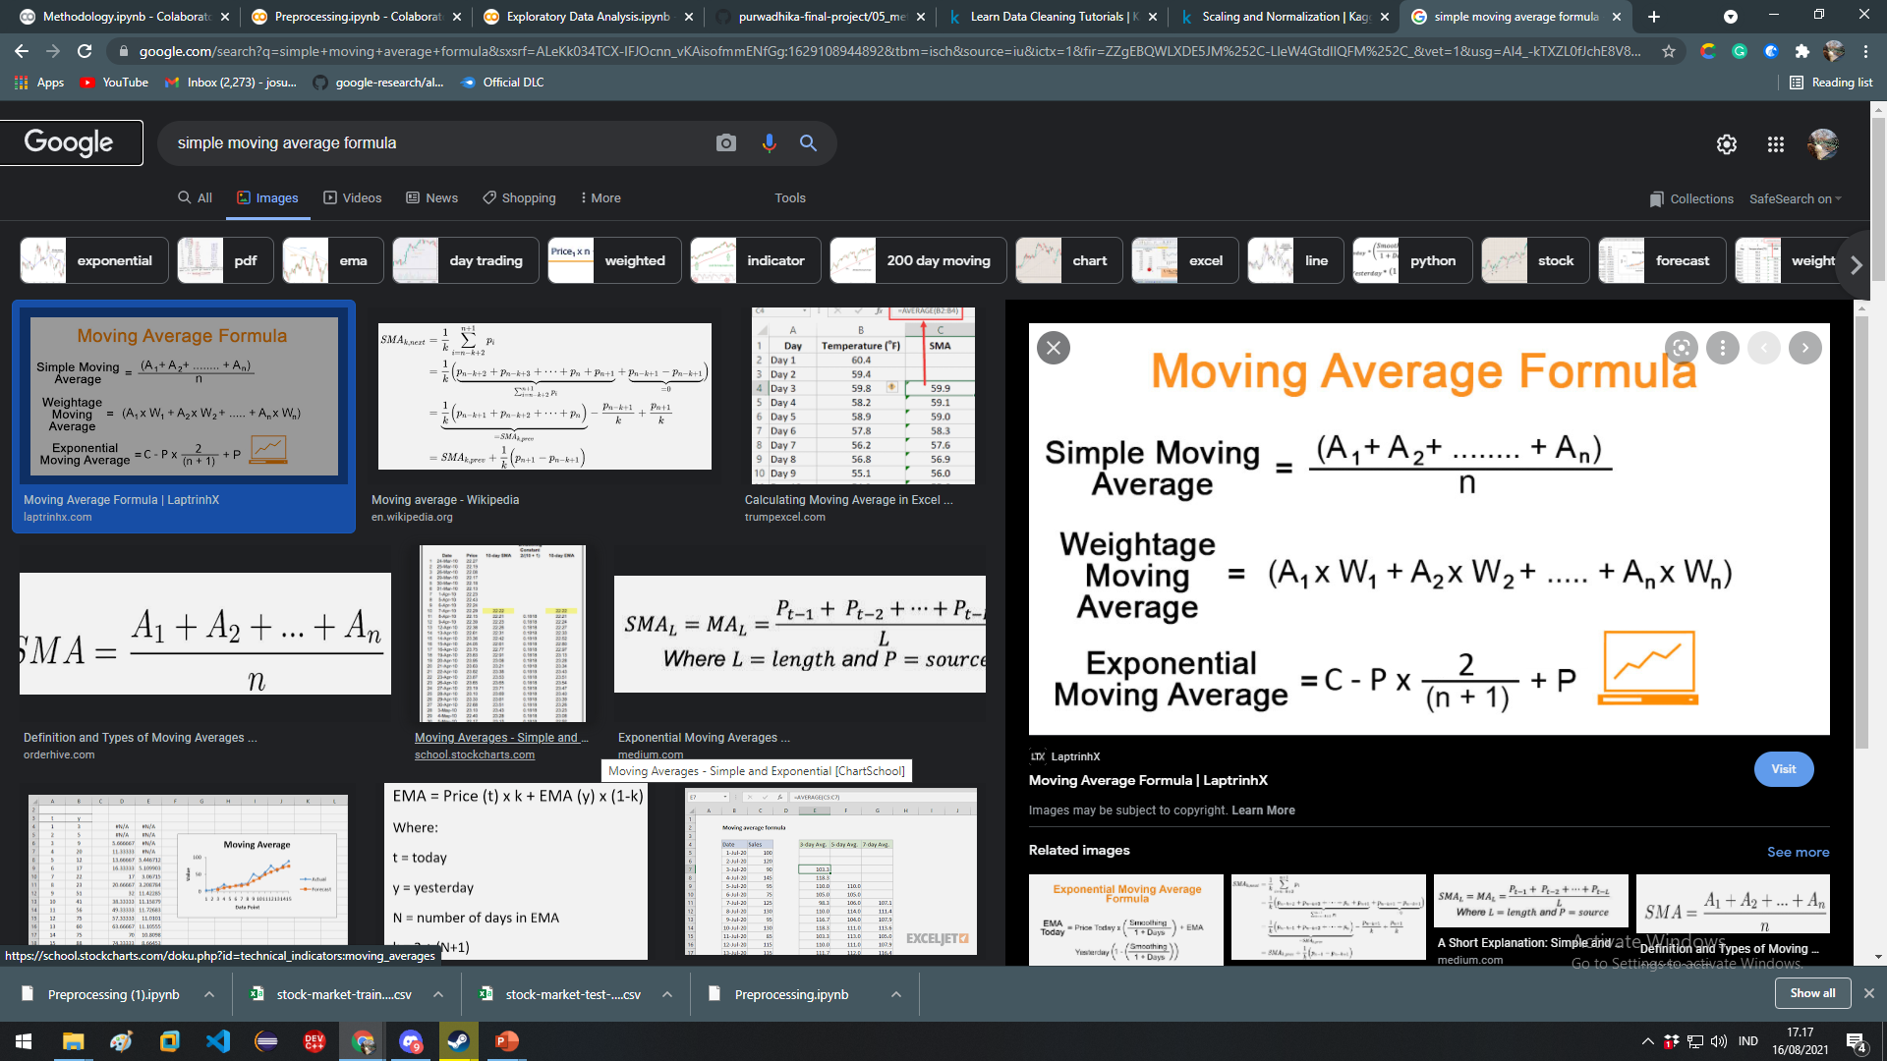
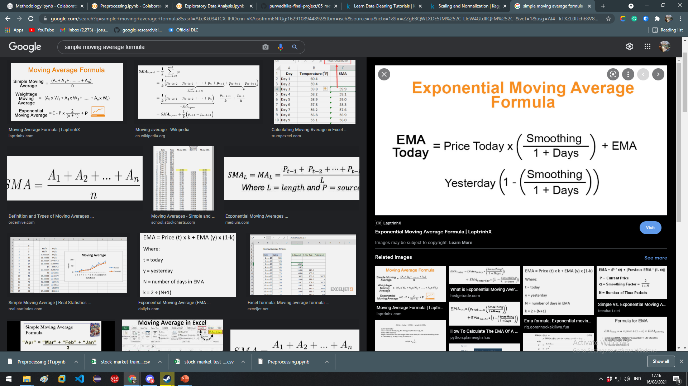
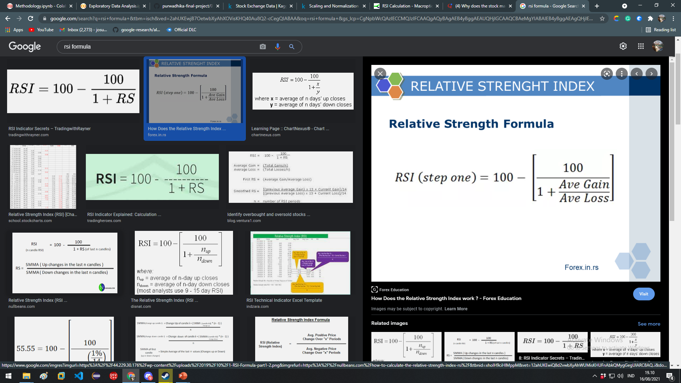
Feature engineering
SMA (Simple Moving Averages)
EMA (Exponential Moving Averages)
CDMA (Convergence Divergence Moving Averages) = 12-EMA – 26-EMA
RSI ( Relative Strength Index ) =
OBV ( On Balance Volume )

Slide 27
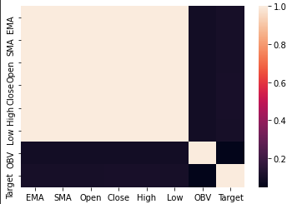
Feature Selection & Encoding
Since SMA have a high linear correlation with price columns we will use the SMA and drop the other three since SMA generalize the trend of the graph better.
Next step we hot encode the indexes column

Slide 28
Modeling Baseline
Baseline model using DummyClassifier
Precision scores: 0.501115055190106
Recall scores: 0.501114973732381
F1 scores: 0.5011050082000984

Slide 29
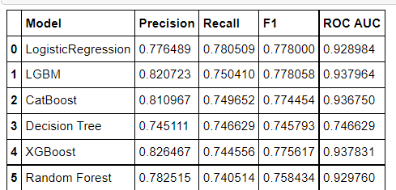
Model Selection

Slide 30
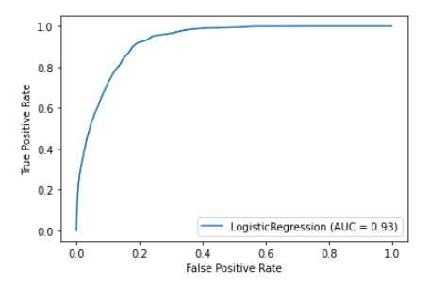
ROC AUC Curve
Since we want to improve on recall we have to move the threshold to get a better score

Slide 31
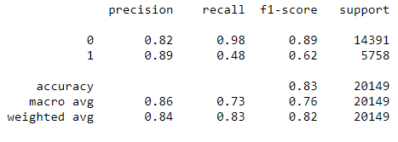
Model Evaluation on unseen data

Slide 32
Conclusion
Logistic regression still prove to be one of the best model to be able to predict the stock market direction trend
The model could help analyst predict the market stock price with promising result in given more time and resource.

